Slide 1

Book Recommendation Chatbot using IBM Watson Assistant
Submitted By: Syed Mohammad Zeeshan Rizvi (United College of Engineering And Research, Roll No-2300100100440)
Submitted To: Mr. R Devnath

Slide 2
Declaration and Acknowledgement
I hereby declare that this project, "Book Recommendation Chatbot using IBM Watson Assistant," is my original work. All concepts, designs, and implementations are the result of my independent efforts, undertaken during the IBM PBEL Virtual Internship.
I extend my sincerest gratitude to Mr. R Devnath, my faculty guide, for his invaluable mentorship and support throughout this project. His insights and guidance were crucial to its successful completion. I am also deeply thankful to the IBM PBEL team for providing this exceptional virtual internship opportunity, which significantly enhanced my practical skills in AI and chatbot development. Finally, I appreciate the continuous support from United College of Engineering and Research, along with my family and friends, whose encouragement made this endeavor possible.

Slide 3
Table of Contents
1
Introduction to the Project
2
Technologies Involved
Understanding the core concept and objectives of the book recommendation chatbot.
A detailed look at the tools and platforms utilized, primarily IBM Watson Assistant.
3
Problem-Solving and Implementation
4
Output Demonstration
Visual evidence of the chatbot's functionality and user interaction.
Exploring challenges encountered and the solutions implemented during development.

Slide 4

Project Overview: Book Recommendation Chatbot
This project focuses on developing a Book Recommendation Chatbot utilizing IBM Watson Assistant. The chatbot's primary function is to suggest books to users based on their preferred genre, such as fantasy, mystery, or science fiction.
By leveraging natural language conversation, it aims to provide an intuitive and efficient way for users to discover new books that align with their interests. The system simplifies the book discovery process by automating recommendations, making it accessible to a wider audience.

Slide 5




Key Features and Functionality
Genre-Based Recommendations
Core Intents
The chatbot identifies book genres using the @genre entity within user input to provide relevant suggestions.
Includes essential intents such as greet, recommend_book, and thanks for natural conversation flow.
Robust Fallback Handling
Easy Web Integration
Incorporates a fallback mechanism to gracefully manage and respond to unrecognized or ambiguous user inputs.
Designed for seamless integration into web platforms using Watson Web Chat, ensuring broad accessibility.

Slide 6
Understanding the Dialog Flow
The dialog flow initiates when a user greets the chatbot or asks for a book suggestion. The Watson Assistant then analyzes the input to detect the relevant genre using the pre-defined @genre entity.
Upon successful genre detection, the chatbot responds with appropriate book recommendations. If the input is not recognized, a dedicated fallback node ensures a polite and helpful response, guiding the user back to the main functionality.

Slide 7
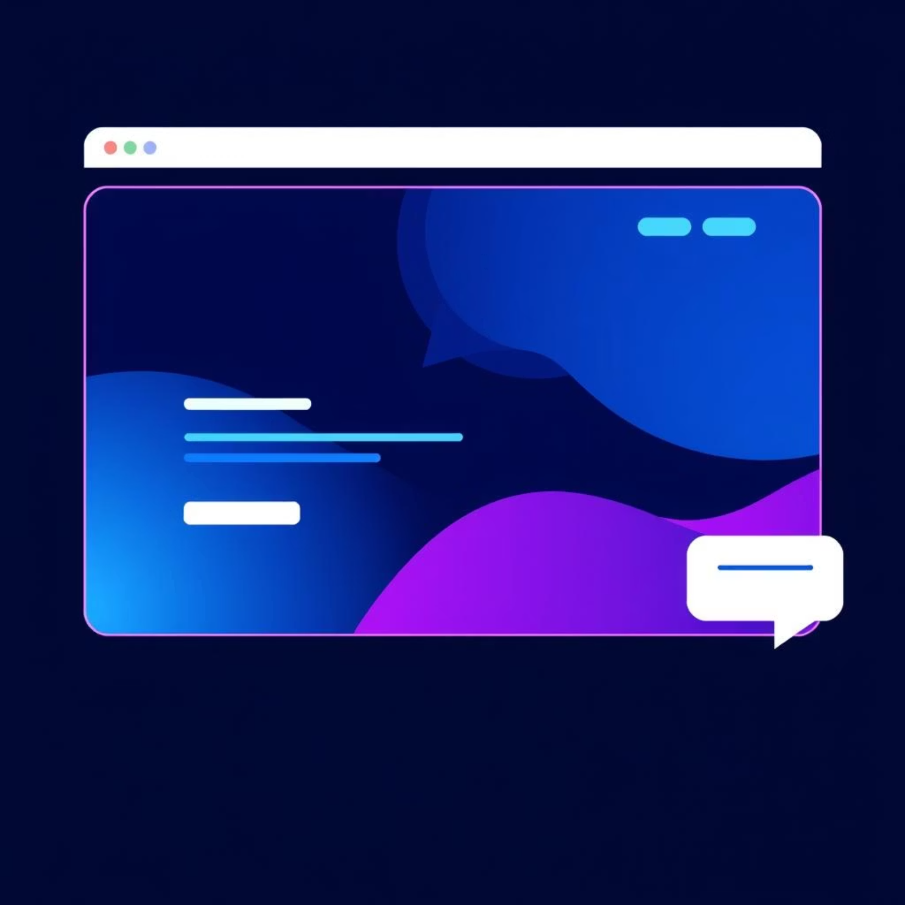
Seamless Website Integration
Integrating the Book Recommendation Chatbot into a website is designed for simplicity and efficiency. The entire integration process is handled by embedding the Watson Assistant Web Chat using a standard <script> tag within the website's HTML.
Once integrated, the chatbot prominently appears in the bottom-right corner of the website, providing immediate access to its services. A key advantage of this setup is that no complex backend code is required; the chatbot runs entirely within the user's browser, minimizing deployment efforts and server-side dependencies.

Slide 8
Problems Faced & Solution Implementation
Challenge: Genre Detection Accuracy
Challenge: Unrecognized Inputs
Challenge: Seamless Web Deployment
Initially, the chatbot struggled with accurately identifying diverse genre inputs from users.
Users occasionally provided inputs that did not match any defined intent, leading to generic responses.
Ensuring the chatbot could be easily embedded without extensive web development knowledge.
Solution: We enhanced the @genre entity with a broader range of synonyms, patterns, and examples, including common misspellings and stylistic variations. This significantly improved the chatbot's understanding of user intent.
Solution: A refined fallback node was implemented to offer more context-aware responses. Instead of a generic "I don't understand," it now guides users by suggesting available commands or popular genres.
Solution: Leveraged the provided Watson Assistant Web Chat script, which handles all frontend integration. This eliminated the need for complex API calls or server-side configurations, making deployment straightforward for any basic website.

Slide 9
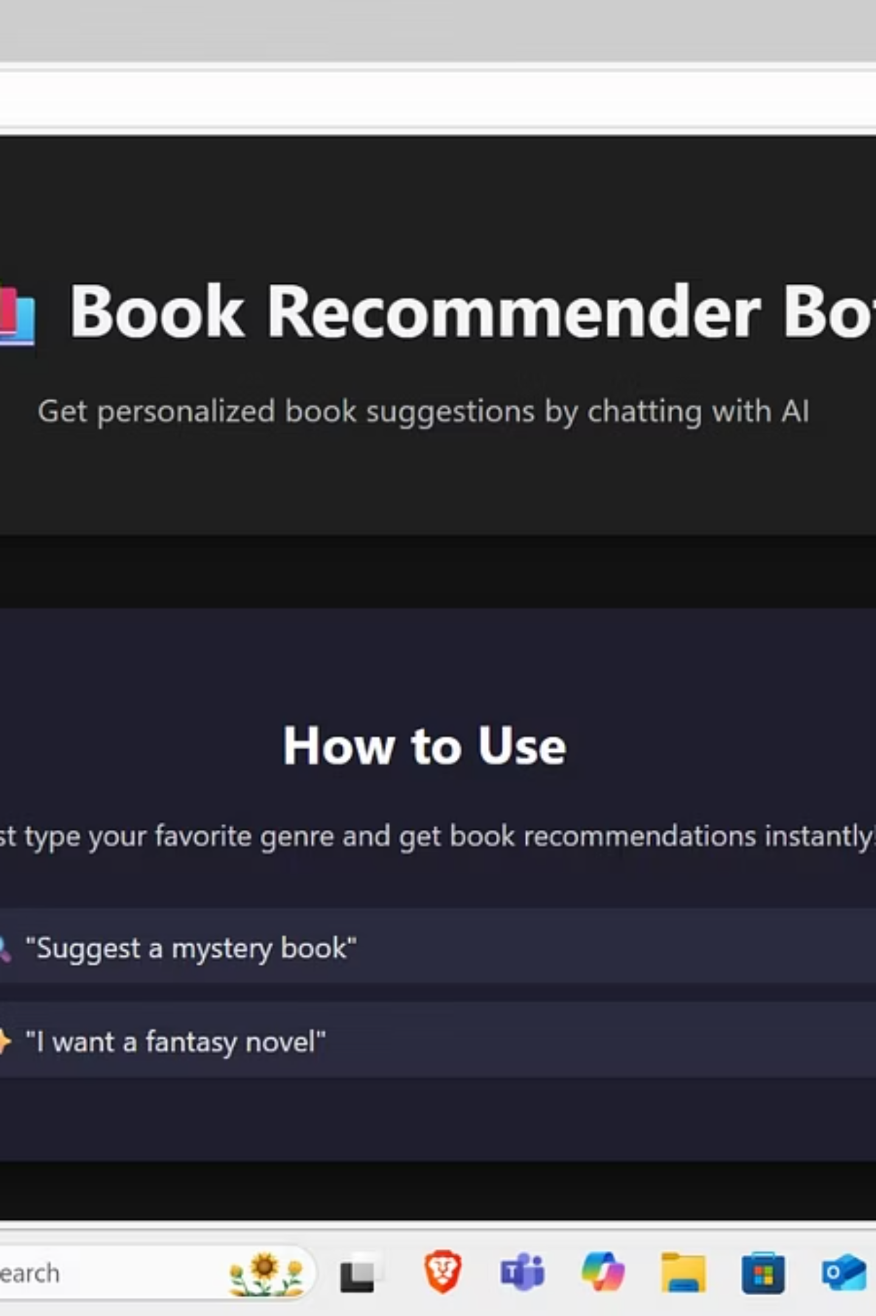
Output Screenshot
This screenshot illustrates a typical interaction with the Book Recommendation Chatbot. The user initiates a query, and the chatbot responds with a genre-based book suggestion, demonstrating its core functionality and user interface within the web chat environment.

